Slide 1
State – Design Pattern

Slide 2
Authors & Presenters
Adam Mcguigan & Sasa Kuzmanovic

Slide 3
Description
The pattern suggests that you extract all state-specific code into a set of distinct classes. As a result, you can add new states or change existing ones independently of each other, reducing the maintenance cost.
Instead of implementing all behaviors on its own, the original object, called context, stores a reference to one of the state objects that represents its current state, and delegates all the state-related work to that object.

Slide 4
What does it do ?
This design pattern solves two main problems:
1. An object should change its behavior when its internal state changes.
2. State-specific behavior should be defined independently. So, adding new states should not affect the behavior of existing states.
State can be considered as an extension of Strategy. Both are based on object composition. Strategy makes these objects independent and unaware of each other. However, State doesn't restrict dependencies between concrete states, letting them alter the state of the context at will.

Slide 5
Advantages of the State pattern
The State pattern minimizes conditional complexity in a program.
It eliminates the need for 'if' and 'switch' statements in objects that have behavior requirements unique to different state transitions.
Single Responsibility Principle. Organize the code related to particular states into separate classes.
The state design pattern also helps in unit testing as adding new behaviors / states won't affect existing behaviors / states

Slide 6
Disadvantages of the State Pattern
The state pattern requires a lot of code to be written.
Depending on how many state transition methods are defined, and how many possible states an object can be, there can quickly be dozens or more different methods that must be written.
Thus, for N states with M transition methods, the total number of methods required will be (N+1)*M.

Slide 7
Example Usage
Examples: Use it in anything that requires state changing, like a Music Player, Player Animations, Combat System(Attack Combos) etc...

Slide 8
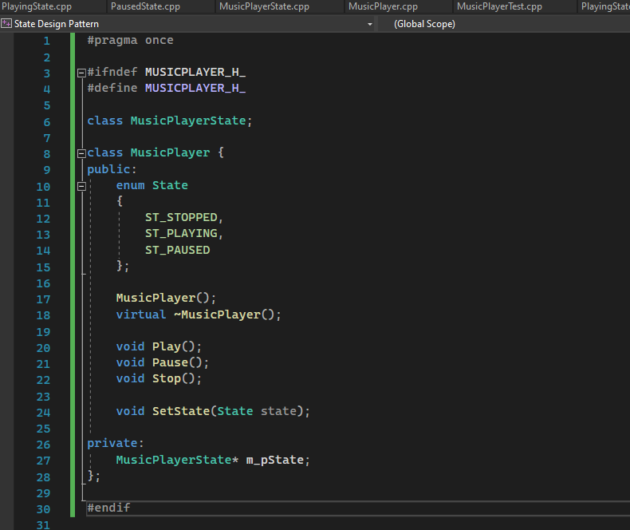
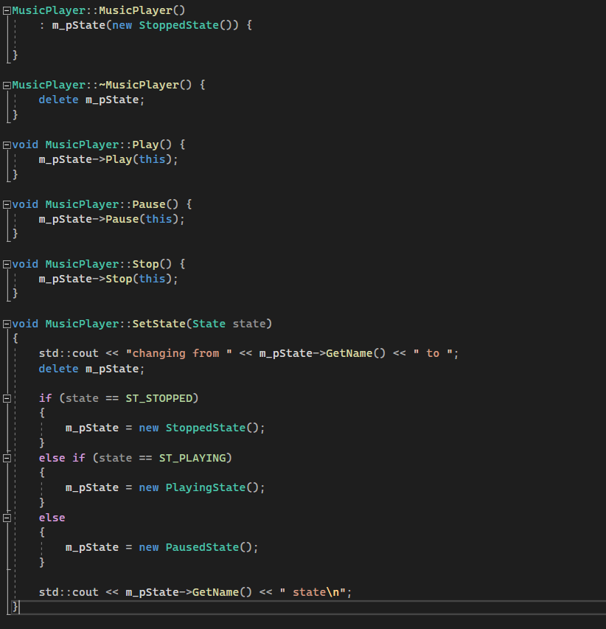
Sample Code

